Slide 1
Yorkshire and Humber Managed Clinical Network
Progress of NHSE Pilot
Michelle Hills – Chair of the Clinical Group of the YHCPCN
July 2019

Slide 2

Agenda
Context – Yorkshire & Humber
The NSHE Draft Service Specification
What are we doing in the Pilot?
Pilot Objectives
  Executive
  Clinical
  Data
  Commissioning
  Workforce & Education
Next Steps

Slide 3
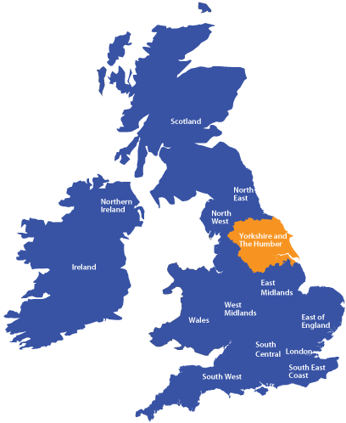
Yorkshire & Humber Region
5.3 million-> 1.1 million -> 3740
16 Local Authorities
2 Tertiary Centres
16 DGH
14 CDOPs
4 Children’s Hospices

Slide 4
Yorkshire & Humber Region

Slide 5
Yorkshire & Humber Region
Fraser et al 2011: Prevalence of LLC 0-19 by Local Authority 2009/10

Slide 6
Yorkshire & Humber
Child Deaths
Average mortality of 407 child deaths per annum
Expected deaths accounted for 64% of all child deaths
Of the expected deaths 77% took place in hospital and only 9% (67) at home, 13% (91) in hospice.
Average of 282 deaths per annum from likely LLC
Major causes of death were perinatal and neonatal events (341) and chromosomal and congenital anomalies (60%). Most neonatal deaths occurred in hospital

Slide 7
Yorkshire & Humber
Current Paediatric Palliative Care
Four Hospices for children – provide care for approximately 1/3 of the children:
Martin House (Wetherby, Leeds) Forget Me Not (Huddersfield)
Bluebell Wood (South Yorkshire) Andy’s (Grimsby)
Geographical gaps in the provision of funded 24/7 out of hours and end of life (EOL) community nursing care
Neither Leeds Children’s nor Sheffield Children’s have specialist pall care teams
There is a diagnosis lottery with good specialist nursing cover for children with cancer but with no such service for others
Flexible community nursing services provide day time care and 24/7 care when required at the EOL – usually goodwill
Not meeting NICE guidelines

Slide 8
Yorkshire & Humber OOH
Data for 14 CCN teams, 2 Oncology Outreach Teams and 1 Helena Team
Weekend cover for CCN Teams
Only 8 /14 CCN teams offer any routine weekend cover - 6 teams provide no weekend service.
Routine on call provision: Very limited by CCNs
Calderdale and Rotherham only. 12 CCN teams have no on call service.
End of Life On call Provision:
12 CCN teams stated they would provide EOL care – 9 in an Ad Hoc fashion (unfunded). 3 are funded (Rotherham, Mid Yorks and Hull).
Two Oncology Outreach teams
Sheffield Helena Team for neurology only

Slide 9
Current Paediatric Palliative Care region
In the region estimate 3740 children living with life-limiting or life-threatening conditions and of these approximately 280 die each year.
High need for hospitalisation for complex children
– particularly towards EOL
10% children PICU account for 50% resource
Cost critical care bed:£849 - £4824/day (NICE 2016)
NICE Guidance is not being met in the region

Slide 10

YHCPCN Strategy
Closing the Gap in Children’s Palliative and End of Life Care: A Strategy for Yorkshire and Humber 2018-2023.

Slide 11
YHCPCN Strategy
Vision
Yorkshire and Humber Children’s Palliative Care Network (YHCPCN)
To close the gap and ensure that every child with a life-limiting condition has access to high quality 24/7 children’s palliative care wherever, however and whenever it is needed.
Mission Statement
The aim of the Yorkshire and Humber Children’s Palliative Care Network is to develop an appropriate and adaptable model of care for all babies, children and young people with life-limiting and life-threatening conditions across the Yorkshire and Humber region, according to need. The focus is to provide choice to families and reduce variation in palliative and end of life care by working together to raise standards for all.​

Slide 12


Agenda
Context – Yorkshire & Humber
The NSHE Draft Service Specification
What are we doing in the Pilot?
Pilot Objectives
  Executive
  Clinical
  Data
  Commissioning
  Workforce & Education
Next Steps

Slide 13
National Focus
NICE Guidance NG61 – templates to support CCG’s data collection
NHSE Draft Service Specification CPC
NHSE Specialised Commissioning Draft Service Specification CPC
Long Term Plan
All ages national strategies EoL

Slide 14
NHSE Draft Service Specification
Written in collaboration with key stakeholders at a number of events
Acknowledges 49000 children with LLC and 15% with no diagnosis
Multiple healthcare needs related to underlying condition and palliative care needs
Broad target outcomes
  More CYP and Families achieve the ‘I can’ statements (choice, coordination, support, 24/7 skilled nurses & specialist paed pall care)
  Improvements in health and wellbeing
  Opportunities for self management
  Carers and family feel supported and needs assessed and addressed

Slide 15
NHSE Draft Service Specification - New definitions
Children and Young People – up to 18th birthday
Palliative Care
  Active and total approach to care from point of diagnosis or recognition
  Throughout life, death and beyond
  Physical, psychological, emotional, social and spiritual
  Enhancement of quality of life
  Management of symptoms, anticipatory planning, complexity and crisis provision
End of life care
  When professionals recognise death is imminent
  Care during and around the time of death and immediately afterwards
Specialist Level palliative care
  Where the focus is on quality of life
  Complex physical, psychological, social, ethical, spiritual needs

Slide 16
NHSE Draft Service Specification
Core MDT
Community Paediatric Palliative Nursing Team
GPs /Primary Care
Care Navigator Role
Education
Managed Clinical Networks
Specialist services provision – Consultants in PPM, Specialist nurses, AHPs
Hospice care
Short breaks
Personalised Care
Advance Care Planning

Slide 17
NHSE Draft Service Specification
24/7 responsive community nursing service and 24/7 advice
Specialist children’s palliative care teams to support
Work at a regional level due to small numbers
Delivery via a MCN
Education and workforce development
Data

Slide 18
YHCPCN Strategy
YHCPCN
Strategy
24/7 Care and Advice
MCN
NICE Guidelines
Training and WF Dev
Regional database
MCN
24/7 Care and Advice
Based on NICE Guidelines
Share Best Practice
Shared digital record (ACP)
Joint commissioning of CPC services
NHSE Service Specification

Slide 19



Agenda
Context – Yorkshire & Humber
The NSHE Draft Service Specification
What are we doing in the Pilot?
Pilot Objectives
  Executive
  Clinical
  Data
  Commissioning
  Workforce & Education
Next Steps

Slide 20
1 Year NHSE Pilot
1 April 19 – 31 Mar 20
Submitted bid outlining Y&H have:
Level 4 Palliative Medicine Consultant to lead the MCN
Network coordinator
Constructive relationships primary, secondary and tertiary services, all 4 children’s hospices, director of MHRC, 3STP/ICS
LOTA, regional compassionate extubation out of PICU document and rapid transfer at EoL pathway
Regional annual conference with in excess of 125 delegates
Our strategy aligns with the draft NHSE Service Specification document

Slide 21
Now we have won the bid, what are we doing?
Agreed a Project Initiation Document (PID) between YHCPCN and NHSE
We are NOT piloting the whole service specification as services are not yet in place and will not be within the year
Outcomes for this year’s pilot are more about
  clarifying the structure of the network and what is needed to be able to deliver the service spec
  Identifying the challenges of delivering the spec
  Gathering findings to support others to develop the spec
  Recognising outcomes are not prescriptive and delivery will look different in different areas
  Trying to understand what data is needed

Slide 22
YH Workshops
Two workshops (March 19) run by Together for Short Lives
attended by staff from across the YH region from NHS and voluntary services incl commissioners
  Understand what the new commissioning model recommends
  Understand what a managed clinical network (MCN) is, what it should comprise and how it should be organised
  SWOT analyses of Yorkshire and Humber Region
  Develop key workstreams
  RACI matrices (who is Responsible, Accountable, Consulted, Informed)

Slide 23
MCN Development
The YHCPCN is becoming a formalised MCN
Representative from all DGH, Tertiary centres, CCN teams
Representative from allied health professions, social care and education – to develop coordinated care
Robust governance and MoU between network and organisations
Links with STPs and CCGs
Data sharing agreement required

Slide 24
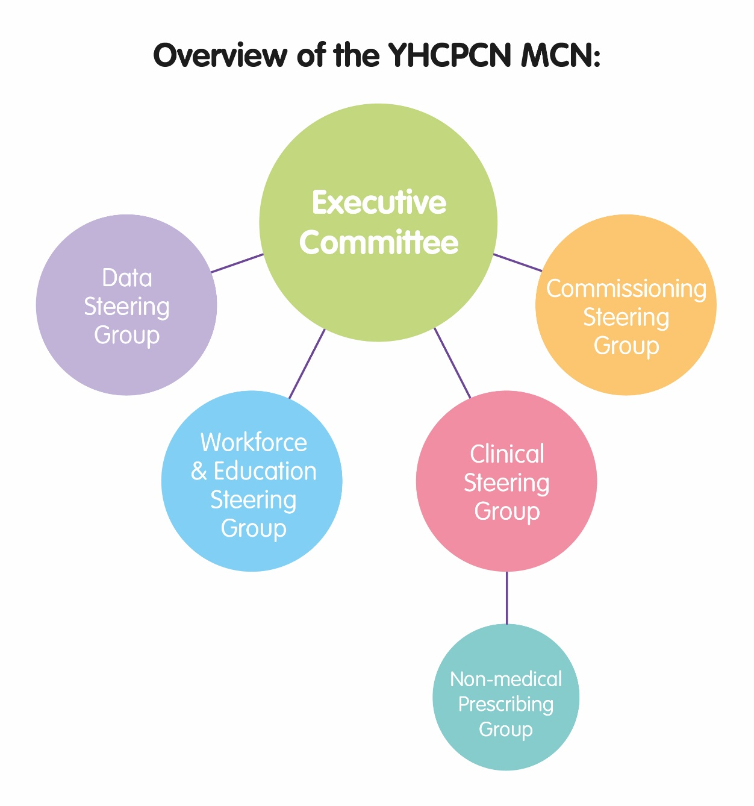

Slide 25
Recommendations for STPs
Include Children’s palliative care/EOL Care work stream in all 3 STPs across the region to plan for and provide resources to deliver high quality care to all babies, children and young people with LLC.
To support representatives to attend the meetings from all Trusts
To ensure that community nursing teams provide flexible 24/7 services to support children to stay out of hospital where possible and particularly to enable EOL care at home
Support the MCN to deliver on the full strategy and NHSE service specification over the next 3 years

Slide 26



Agenda
Context – Yorkshire & Humber
The NSHE Draft Service Specification
What are we doing in the Pilot?
Pilot Objectives
  Executive
  Clinical
  Data
  Commissioning
  Workforce & Education
Next Steps

Slide 27
Executive Network Framework
Develop governance framework for the network
Develop a commissioning group across the ICS/STP and local authorities that has governance into network board
Develop steering groups for work streams with leads and clear objectives identified- each group to develop action plan and report to network board
Confirm evaluation processes and responsibilities
Confirm future funding of network and ownership
Develop guidance re how to and costs of setting up a MCN
Evaluation

Slide 28
Clinical - Objectives
Explore opportunities to offer regional 24/7 care embedding the model within existing out of hours care services
Produce business plans for regional and sub regional OOH access to specialist advice including indicative costs- to include shared database, 24/7 advice line and 24/7 children’s community nursing service
Explore opportunities for sub-regional OOH specialist nursing in the community – recommendations to network board
Develop process of holistic personalized care and support plan such as the CYPACP
Develop pathways for families to benefit from social prescribing from NHSE
Examine opportunities for personal health budgets NHSE
Develop policy for dealing with contentious cases
Feedback to NHSE on suitability of the service spec including recommendations for minimum standards

Slide 29
Clinical – 24/7
24/7 task and finish group
  First met May 19 - Explore opportunities to offer 24/7 care - Initial options appraisal with SWOT analysis
  Considered 'POON' central specialist palliative care team model, rapid response community model, flexible response, trading services and hospice models
  Meeting June 19 - Recognise need for hybrid model with central expert team and local flexible response
  It is not felt possible to meet the NHSE service spec or provide good care without both
  Put patients onto the on call list (when end of life or symptoms out of control) and parents/local professionals can call specialist team

Slide 30
Clinical - Specialist
Leeds Teaching Hospitals NHS Trust and Sheffield Children’s NHS Foundation Trust have both submitted bids for specialist palliative care team
  including consultant and nurse time and pharmacy/psychology
EMBRACE the YH acute transport service have been contacted regarding the potential of coordinating on call specialist advice line

Slide 31
Clinical - Challenges
How to release doctors from jobs with different trusts and hospices to participate in on call system
Shortage of adequately trained staff
How to have one governance structure?
Data sharing agreement
Need honorary contracts, admin costs, coordination of service, consider travel costs and practicalities of equipment, medical indemnity
Must have advance care plans at a minimum and good communication
Lone working issues in palliative care

Slide 32
Clinical – Funding
Central specialist team funding would need to come from specialised commissioning and the community nurses extended hours from CCG
If large numbers we could do block contract
Small number areas need a separate budget – to ensure staff get payment
Not a single team with high enough numbers so will need a separate budget line
Traded services – CCG may put money in but attach it to a team and they may need to buy in that service
Smaller CCGs would have to pay in a bit anyway otherwise not fair (and top up as required).

Slide 33
Clinical – Other Activities
Have network support to endorse CYPACP across the region
Develop clear pathways for families to benefit from social prescribing
  May 19 local social prescribing lead contacted
  June 19 local lead presented social prescribing at YHCPCN clinical meeting
  June 19 Network coordinator and clinical chair obtained social prescribing online network access
  Questionable how useful this will be for children’s palliative care
Develop policy for dealing with contentious cases - Reviewed Nuffield & RCPCH guidance. Appointed lead for this piece of work

Slide 34
Data Collection - Objectives
Scope data collection and undertake a digital maturity assessment (starting with the hospices) highlighting the level of readiness, capability and infrastructure and confirm what is currently collected at a national level
Link LHCRE Y&H
Develop methods to extend the use of the Community Services Dataset
Produce a recommendations report with pathway on future data collection required

Slide 35
Data Collection - Progress
Developed a data steering group to focus on the task of data collection across the network for the pilot.
This is to include hospice activity data (which was thought to be a requirement of the Hospice grant funding) and supporting the hospices to all be in a position to submit to the CSDS moving forward
We are also linking in with the Yorkshire and Humber pilot of the LHCRE to try and develop a shared care record
Data will inform the whole project so we have developed a self-assessment form based on the service specification for providers and commissioners to fill in.

Slide 36
Data Collection - Challenges
Progress slow & high expectations of what can be accessed
Individual organisations do not collect all the data for CSDS
The work required to collect the CSDS is great
Data available is inconsistent and in different formats
Organisations are reluctant to share some of the data that is available
£25M funding for hospices was excellent but lost the carrot for hospices to submit data to CSDS
Key data to be collected still needs clarified
SNO-MED codes for children’s palliative cares yet to be agreed
Resources implications for the hospices are big issue at present
More meetings next week with NHS Digital

Slide 37
Commissioning - Objectives
Map current spend on palliative and end of life including spec OOH across each CCG, ICS and regional providers
Map activity in hospices across the region in percentage and population terms across the hospice offer eg bereavement support, short breaks, continuing care, EoL
Confirm average costings at service, ICS, STP and CCH level based on population and historical usage data
Confirm resource from NHSE specialist commissioning for specialist care elements
Carry out Integrated Impact Assessment

Slide 38
Commissioning - Progress
The network have developed a commissioning steering group which NHSE are supporting
Launch meeting 17th June
STP/ICS footprint meetings taking place to look at service development and commissioning across these footprints
To implement the service specification commissioners need to be fully engaged so that is our task over the coming months
Have asked commissioners to provide an update regarding the palliative care services they commission in their locality and will pull this together per STP/ICS area and feedback.

Slide 39
Workforce and Education - Objectives
Deliver annual conference
Develop training and education needs analysis and supporting plan for workforce including CYPACP and ECHO system
Develop communication strategy for promotion of training
Undertake a recruitment gap analysis and supporting plan

Slide 40
Workforce and Education - Progress
Workforce skills gap analysis and recruitment gap analysis not yet completed
Education itself already a strong area for YHCPCN
  2020 regional conference being organized
  Children's Palliative Care Module and Study Days
  Website and email lists

Slide 41


Agenda
Context – Yorkshire & Humber
The NSHE Draft Service Specification
What are we doing in the Pilot?
Pilot Objectives
  Executive
  Clinical
  Data
  Commissioning
  Workforce & Education
Next Steps
We’ll do it!

Slide 42
Next Steps
Continue to develop the MCN and working groups from the outcome of the TfSL workshops pilot
Work on Q2 targets within the PID
Engage all STP/ICS – action planning to implement NHSE service spec and strategy
Develop commissioning forums in STP/ICS footprints
Develop a communication strategy
Ensure user involvement

Slide 43
Key takeaway messages
Aims and ideals of the service spec are good
Challenging to implement and cannot be done on a shoestring
We aim to share learning & be open about challenges and requirements
We want to support others to develop MCN
Will look different in different areas
Hopefully our pilot will deliver transferable learning about how to structure a network and work closely with STPs/commissioners and influence delivery of high quality palliative care

Slide 44




Contact Details
Michelle Hills
Michelle.hills@nhs.net
www.yhcpcn.org.uk
@YoHCPCN

